Slide 1
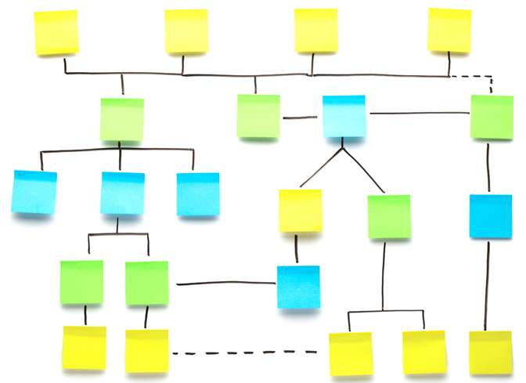
Deloitte LEAN
LEAN Enhanced Agile for eNterprises
Design Your Own Agile Method

Slide 2
Five simple techniques to increase the agility in your current process

Slide 3
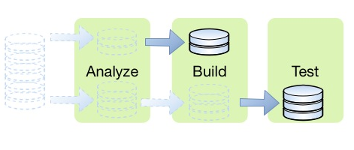
Describe planning units as increments of business value, and treat them as atomic units that can be designed and delivered independently
%
Business Goals
Business Capabilities
Solution Feature
Atomic units of work
e..g. Increase Revenue by $1,000,000
e..g. Up-sell to customers ($100,000)
e..g. 360 degree customer view ($10,000)
e..g. Search products by customer name ($1,000)
All business capabilities are mapped to solution features to reduce missing requirements
Atomic units independently flow through the SDLC and provide incremental business value

Slide 4
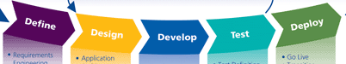
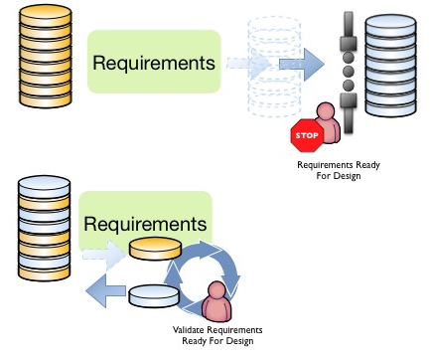
Replace Stage Gates with time boxed reviews and other activities completed at a regularly scheduled cadence
Stage Gates calls focus to be allocated to the wrong programs
Healthy programs make it this stage gate on time, unnecessarily get more revues
Unhealthy programs are late, and receive less stage gate reviews
Replace stage gates with regularly scheduled cadence
Force a quality check of all work in process
Ensures that work is progressing according to governance
Makes any bottlenecks in review capacity obvious
Frees work to flow independently

Slide 5
Use visualization to make sure that everyone understands what the processes are, and where the current work fits into that process
Work is blocked
Work is blocked
Work is blocked
Bottleneck
Team is idle
Requirements & Analysis
Development
Test
UAT
Input Queue
(3)
(4)
(3)
(2)
Done
(8)
IP
Done
IP
Done
IP
Done
IP
Done
New Build
B
(12)
D
Maintenance
(2)
Prod Defect Fix
B
(6)
- Work tickets must be reviewed once every two weeks.
- Developers must put current work on-hold if a high severity defect is found in test.
- Only 1 work ticket can be assigned to any tester at any given time.
Work Ticket
B
Blocker
Board Policies
D
Defect

Slide 6
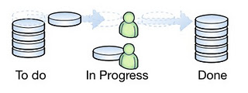
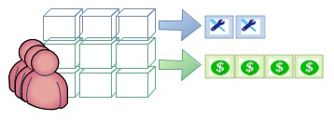
Limit Consumption of Demand According to the Capacity of Workers to Satisfy That Demand
Knowledge work perishes fast
old work is harder to process
loses value quickly
Increases management overhead
Causes multitasking
Process work in small increments, limited to what can be completed in the short-term
Invest Time and Capital To Improve the Way Work Is Completed
Knowledge work involves learning
Slow down, adjust direction, and speed up
Adapt to new context frequently

Slide 7
To get started on building more agility into a software development process, start by answering the following questions
What are the units of work you want to track?
Use cases, user stories, features, defects, work packages
Choose where the process will leverage stage gates and cadence
Time boxing, or single piece flow (core development, entire SDLC, governance and prioritization, etc.)
How do we want to visualize our work?
Physical card wall, spreadsheets, web-based electronic tools
What is our strategy to engage in continuous improvement? How will we identify and resolve problems that are affecting quality and delivery speed?
Retrospectives, operational reviews, 5 whys, value stream mapping

Slide 8
Building Your Own Agile Method

Slide 9
Agile means different things to different people, knowledge workers can draw upon a diverse repository of agile process frameworks
A thinking and management framework that guides organizations into an agile culture
Employees are empowered to experiment and improve by using economic and performance data
Value Stream/
Network
Mapping
A3
Management
Flow Based
Delivery
Kanban
Behavior
Driven
Development
Agile
Modeling
Methods
Domain
Driven
Design
Supplementary agile practices dedicated to requirements, design, architecture and testing
Emphasis on Just-In-Time and “Just Enough” approaches
Agile
Use Cases
Core agile method focused on helping teams deliver excellent results
Emphasis on people, collaboration, and responding to change
eXtreme
Programming
Scrum
Feature Driven
Development
Software Craftsmanship
DevOps
Movements (as opposed to methods) dedicated to delivery and operational excellence
Focused on using technical best practices to support agility
A set of phases, artifacts and roles that are largely correct, providing structure to help agile scale
Significant Expertise is required to implement in a agile fashion
RUP Lifecycle

Slide 10
Each agile framework provides distinct capabilities enabled through discrete practices, choose the practices that best fit your problem domain
Planning
Requirements
Architecture / Design
Development and Testing
Scrum / XP
Scrum / XP
XP
XP
Agile Modeling
Agile Modeling
XP
Release Plan
Iteration Burndown Chart
Definition of Done
Planning Poker / Game
Backlog
Story
System Metaphor
Model Storming
Self-documenting Code
Continuous Integration
Refactoring
Release Burndown Chart
Agile Work/Planning Board
Blockers and Issues
Daily Standups
Story Map
Scenario
Spike
Agile Class and Sequence Diagrams
Potentially Shippable Code
Automated Builds
Pair Programming
Iteration Plan
Tasks
Retrospectives
Self-organizing Teams
Epics/ Themes
Acceptance Criteria
Class Responsibility Collaboration
Other models as necessary
Test-driven Development
Iteration Review
Collective Code Ownership
Other
RUP
Kanban
Domain Driven Design
Code Craftsmanship
Acceptance Test Driven Plans
Information Radiators
Collaborative Workspaces
Product Lifecycle
Minimum / Marketable Feature Set
Features
Domain / Service Model
Emerging Design
Other
User Acceptance Tests
Exploratory Test
Application Lifecycle Management
Kanban
Agile Modeling Method
Bounded Context Maps
RUP
Kanban Workboard
Work Ticket Types
Cumulative Flow Diagram
Statistical Process Control Chart
Backlog
Story
Software Architecture Description
Ubiquitous Language
Technical Tests (e.g. Security, performance)
Defects
Operations and Support Manual
Story Map
Scenario
Architecture Key Mechanism
Policies
Classes of Service w/ Delivery Promise
Cost of Delay
Issue Management
Other
Wiki Project Repository
4 + 1 views
RUP
BDD
Operational Review
Work in Limit Policies
Other Lean Metrics Dashboard
Portfolio Kanban
Epics/ Themes
Acceptance Criteria
Architecture Reference
Acceptance Test Driven Development
Lean
Agile Modeling Model
Code Craftsmanship
DevOps
Kaizen
Value Stream Map
A3
5 Whys
Low fidelity UI Mockup
Features
Code Katas
Continuous Deployment
SOLID Practices

Slide 11
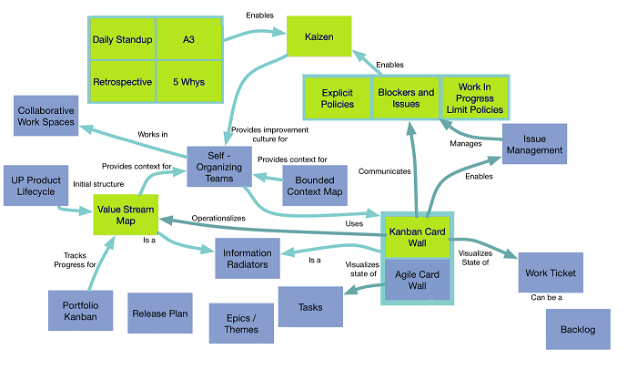
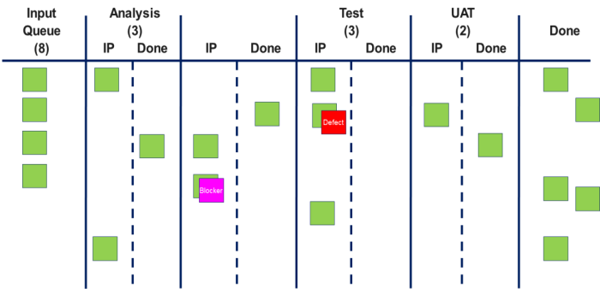
Every project has a different context, a useful playbook will provide a framework that allows you to select the practices that are appropriate , and refine the process over time using a measurable, continuous improvement approach
What is your context?
Select your tools…
Structure and visualize current processes to identify pain points and areas for improvements.
Value Stream Mapping
5 Whys
Demand Analysis
Etc..
Select an appropriate combination of Agile tools and practices to create a synergistic method.
Kaizen
A3
Daily Standup
Etc..
1
2
Operate
Operate your Agile transformation using Kanban.
Kanban Card Wall
Explicit Policies
Blockers and Issues
WIP Limits
Etc..
3

Slide 12
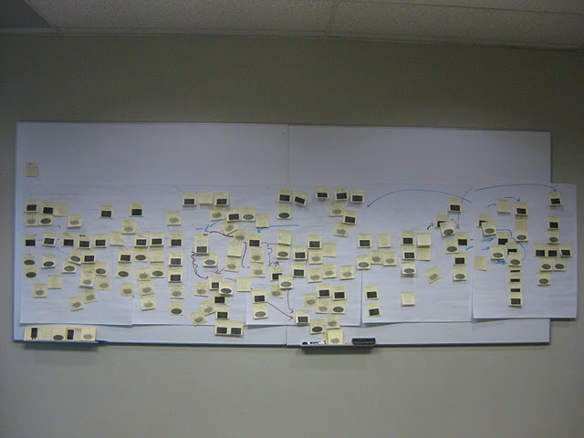
Start by evaluating your current process, identifying top pain points, getting to root cause, and agreeing on the activities and interactions across all project participants
Value Stream Mapping – Understanding Your Process
Gain agreement on existing and ideal handoffs, interactions, and how work passes between knowledge workers
Collaboratively, build the design that matches your capability and your current environment
Use a lightweight approach, design quickly, and be ready to change on-demand
Agree on top pain points and quick hits solutions
Determine where agile can support, and where traditional approaches make more sense

Slide 13
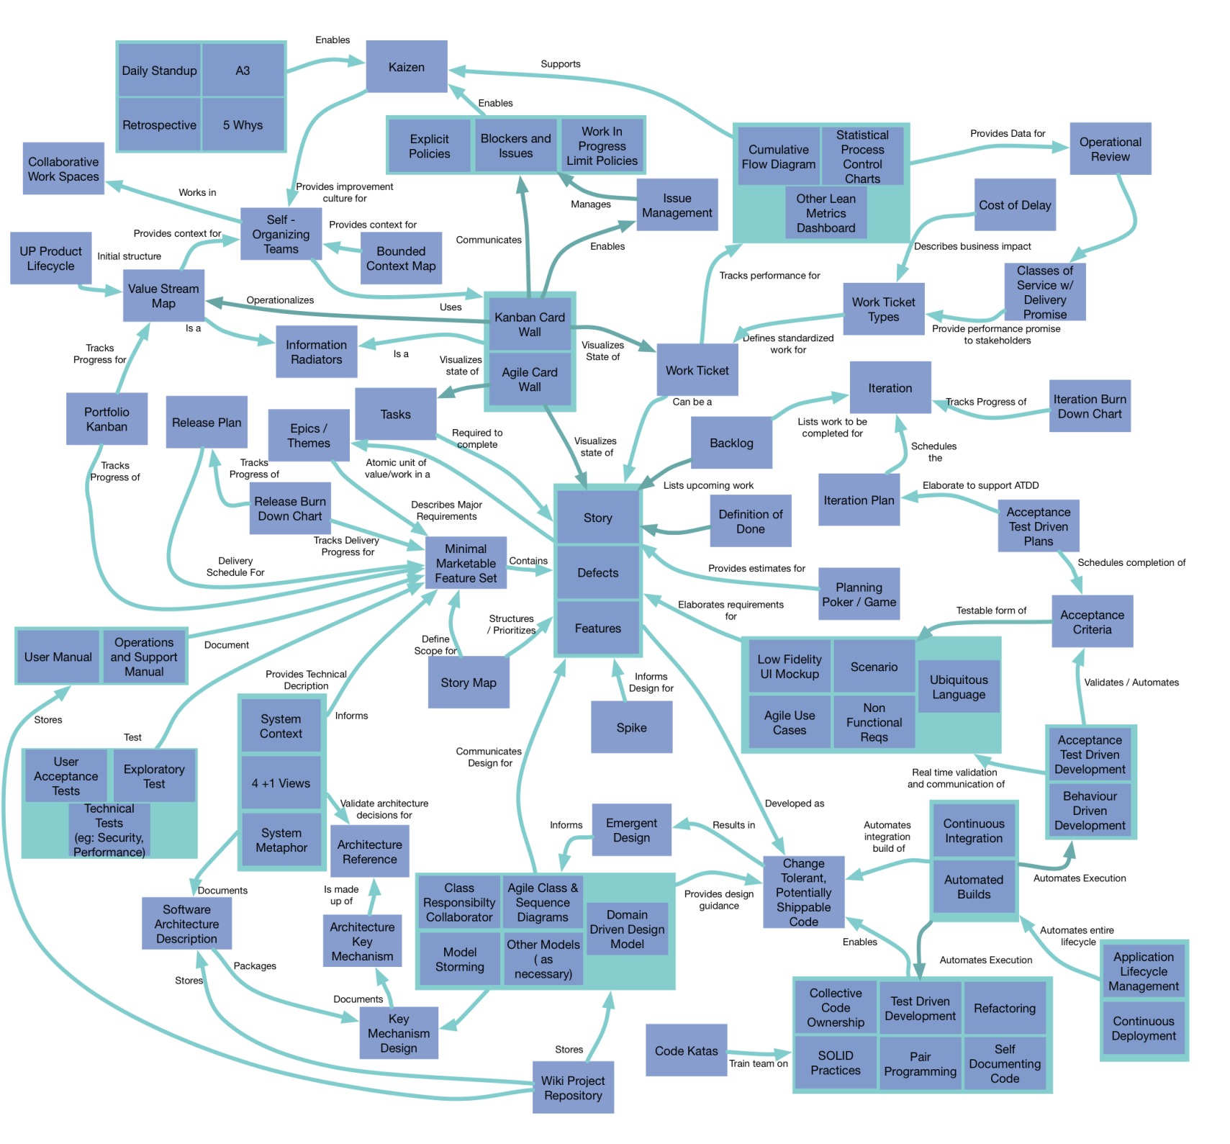
Select which agile practices to adopt, being mindful of problems and root cause
Agile practices are synergistic; choosing multiple, interacting practices provide a magnitude of order extra benefit than separate practices alone
Management Practices
Technical
Practices

Slide 14
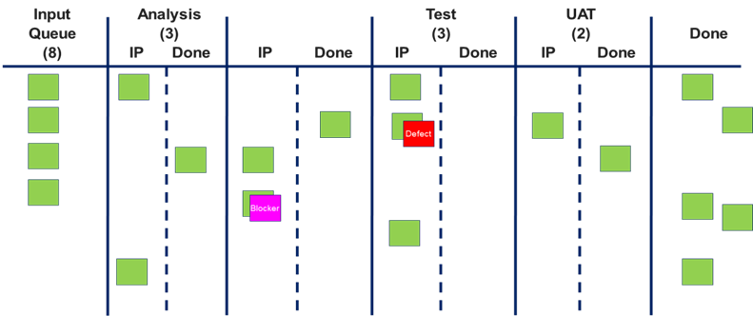
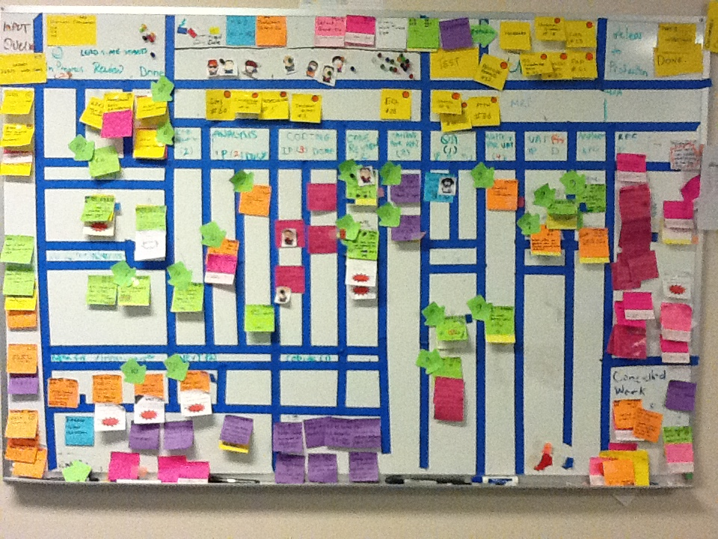
Leverage Kanban to design and operationalize your target method, visualize work, limit working in progress, and incrementally improve
Incremental change will maximize your chances at adopting a new method
Visualize the way you are working using agile techniques like card walls
Gradually enforce limits to demand, equivalent to capacity
Incrementally change work policies, handoff agreements between teams, adoption of new agile practices, and other “micro” improvements
Identify bottlenecks, blockers, and performance outliers and adjust system of work to prevent them from happening again
Enabling agile continuous improvement culture, further paving the way for adopting other agile practices

Slide 15
Agile Methods

Slide 16
Scrum focuses on recommending a few simple practices to enable a highly iterative, cross functional, collaborative approach to agile delivery
Product owner creates a prioritized wish list called a product backlog
Items may be described using epics, themes, and organized into a user story map
During iteration planning, the team pulls user stories from the iteration backlog
Work is completed within a iteration
Progress is assessed with daily standups
Progress maybe may be tracked on a agile work board
At the end of the iteration , the work should be potentially shippable
The iteration ends with review and retrospective.
The iteration ends with a review and retrospective.
As the next iteration begins, the process repeats
Iteration Burndown Chart
Blockers and Issues
24 H
Tasks
Daily Standups
Planning Poker / Game
Retrospectives
2-4
Weeks
Iteration Plan/Sprint Backlog
Definition of Done
Epics/ Themes
User Story Map
Release Plan
User Story
Release Burndown Chart
Release
Product Backlog
Agile Work/
Planning Board
Self-organizing Teams

Slide 17
Extreme Programming supports iterative feedback cycle through explicit technical practices supporting high-quality code just-in-time
Development team works with the customers to write requirements as user stories and creates a release plan
Development team creates an iteration plan time-boxed from 1-3 weeks in length, spikes are created to understand unknown risks
Daily standups are conducted with the entire development team
Acceptance criteria is written/refined for each user story before coding starts and design is done just-in-time with Class Responsibility Collaboration cards
As the design emerges a system metaphor is defined and used to communicate the system design
Developers code the unit tests first and then write the application code pairing with another developer, onsite customer is available to clarify/refine stories
Code is checked in at least daily, shared and owned by the entire team and developers are empowered to refactor any portion of the code base to support new changes
Automated tests, continuous integration with automated builds run often to validate the entire code base
Potentially shippable code is delivered at the end of each iteration, and the process repeats
Release Burndown Chart
Iteration
Iteration Burndown Chart
Development
Class Responsibility Collaboration
Collective Code Ownership
Story
Acceptance Criteria
Continuous Integration
Acceptance Test Driven Development
System Metaphor
Release Plan
Iteration Plan
Daily Standups
Test-driven Development
Pair Programming
Test-driven Development
Release
Tasks
Automated Builds
Potentially Shippable Code
Defects
Self-documenting Code
Refactoring
Spike
Self-organizing Teams

Slide 18
The Agile Modeling Method provides a framework to enable best in class system modeling using an iterative, evolutionary, and emergent approach
Initial model envisioning is conducted for the overall set of requirements in the backlog by defining a high-level system context with other light-weight architecture design artifacts
Iteration modeling is conducted during each iteration to model just good enough to give good estimates and inform iteration planning
Additional design through model storming occurs just-in-time and the architecture model is captured through multiple models such as Agile Class and Sequence Diagrams and Domain Driven Design
Technical practices such as test-driven development and acceptance-test driven development is applied during coding, models are proved with code and any changes are fed back into the models
Models are displayed publicly and collaboration platforms such as a Wiki Project Repository is used to capture models
The team models a bit ahead as needed to reduce overall risk as the team moves forward
Model Storming
Test-driven Development
Backlog
Iteration
Model Envisioning
Model a Bit Ahead
Emergent Design
System Context
Acceptance Test Driven Development
Architecture Key Mechanism
4 + 1 views
Multiple Models
Software Architecture Description
Class Responsibility Collaborator
Domain Driven Design Model
Agile Class & Sequence Diagrams
Other Models
Document continuously
Document Late
Multiple Models in Parallel
Wiki Project Repository
Single Source of Information

Slide 19
Modeling Storm
The Deloitte LEAN approach is an evolving set of agile practices to provide best-in-class agility for enterprise scale projects
Modeling
Quality and Continuous Improvement
Retrospective
Class Responsibility Collaborator
Domain Driven Design Model
Agile Use Cases
Cumulative Flow Diagram
Statistical Process Control Charts
Agile Class & Sequence Diagrams
Architecture Key Mechanism
Behaviour Driven Development
Other Lean Metrics Dashboard
5 Whys
Wiki Project Repository
Planning and
Prioritization
Delivery
Planning Poker
Collective Code Ownership
Minimal Marketable Feature Set
User Story Map
Emergent Design
User Story
Continuous Integration
Acceptance Test Driven Development
Release Plan
Cost of Delay
Daily Standups
Acceptance Criteria
Test-driven Development
Pair Programming
Work Ticket Types
Automated Builds
Features
Spikes
Change Tolerant, Potentially Shippable Code
Acceptance Test Driven Planning
Classes of Service w/ Delivery Promises
Self-documenting Code
Refactoring
Delivery Management
Kanban Card Wall
Work In Progress Limit Policies
Blockers and Issues
Explicit Policies
Operational Control Review

Slide 20
Agile Practices

Slide 21
User Acceptance Tests (UAT)
User Acceptance Tests are tests written by business users or with their input, taking into account only real world scenarios, to define the acceptance criteria for the system to meet in order to address business needs. It will help validate the system in a real business environment. A Subject Matter Expert, usually the owner or client of the object under test, provides confirmation of UAT pass/fail status after a review, which takes place during the final stages of a project and often occurs before a client or customer accepts the new system. UAT does not always occur in the end, in fact it’s encouraged for these tests to be run frequently and there can be different cadences (every iteration/sprint, every time a feature is developed, etc.) .
For more information: http://en.wikipedia.org/wiki/Acceptance_testing#User_acceptance_testing

Slide 22
User Acceptance Tests (Types)
XP: in XP UATs are created from user stories that were selected during the iteration planning meeting. The customer specifies scenarios to test when a user story has been correctly implemented. A story can have one or many acceptance tests, what ever it takes to ensure the functionality works.
SCRUM: An iteration starts by sprint planning and finishes with a sprint demo and a sprint retrospective. During the iteration, the product owner meets the technical lead and the team's tester in a session where the acceptance tests for the selected user stories are created. The role of the tester during this session is to help the product owner to think of the various scenarios under which the functionality will be used. Each of these detailed characteristic are written as acceptance criteria in the following format:
GIVEN [an initial context] WHEN [some event happens] THEN [an expected state linked to the functionality]
RUP: In RUP, UAT is performed in the concluding Transition phase of a discipline that is user acceptance testable
For more information:
http://www.extremeprogramming.org/rules/functionaltests.html
http://citconf.com/wiki/index.php?title=User_Acceptance_Test_Driven_Development_in_a_Scrum_Team_using_Fitnesse_%26_How_people_use_Fitnesse
http://www.summa-tech.com/about/methodology/meth_rup.php4

Slide 23
Exploratory Tests
Exploratory testing is simultaneously learning, designing and executing tests. Cem Kaner, who first used the term, now defines exploratory testing as "a style of software testing that emphasizes the personal freedom and responsibility of the individual tester to continually optimize the quality of his/her work by treating test-related learning, test design, test execution, and test result interpretation as mutually supportive activities that run in parallel throughout the project."
For more information: http://en.wikipedia.org/wiki/Exploratory_testing

Slide 24
Technical Tests
Technical tests are tests that measure functionalities of a system from an architectural and technical perspective, assessing the system based on non-functional requirements. Technical test may measure the following qualities of a system:
Reliability
Efficiency
Maintainability
Portability
Performance
Scalability
Security
For more information: http://en.wikipedia.org/wiki/Software_testing

Slide 25
Defects
A software defect or bug is an error, flaw, mistake, failure, or fault in a computer program or system that produces an incorrect or unexpected result, or causes it to behave in unintended ways. It may be a “material breach” of the contract for sale or license of the software if it is so serious that the customer can justifiably demand a fix or can cancel the contract, return the software, and demand a refund.
For more information: http://en.wikipedia.org/wiki/Software_bug

Slide 26
Agile Application Lifecycle Management (ALM)
Agile ALM is an Agile continuous process of managing the life of an application through governance, development and maintenance by tools that facilitate and integrate requirements management, architecture, coding, testing, tracking, and release management. ThoughtWorks defines the five practices for Agile ALM as follows:
Evolve Process Definition – the most effective process for any software initiative must be continuously discovered, evolved and refined over time
Embrace Heterogeneity – every software project is different, processes cannot be completely standardized across all teams
Build the Right Thing – embed customers and business people into the day-to-day activities of software teams
Practice Continuous Delivery – continuously delivers a few features every couple of days or weeks, instead of a bunch of features once a quarter
Orchestrate, Don't Manage – call upon all upon company leaders and managers to become orchestrators by making sure the work being done is aligned with business goals, removing obstacles, fixing bad projects, understanding the portfolio, and helping to spread best-practices across teams
For more information: http://www.thoughtworks-studios.com/company/07-06-2011-thoughtworks-studios-defines-agile-alm-in-new-white-paper

Slide 27
Operations Support Manual
An operations support manual is a manual written to support easy cross-system troubleshooting and documentation to increase efficiency in running IT environments. Operations activities include using tables, charts, and matrices for monitoring servers, backups, scheduling tasks, managing inventory, and performing follow-up reports on outstanding issues. The manual may include:
Product installation and maintenance
System description, operations, backup, recovery
Data and software administration
For more information: http://www.klariti.com/technical-writing/operating-manuals-tutorial.shtml

Slide 28
Code Katas
A code kata is an exercise in programming which helps a programmer hone their skills through practice and repetition. They are small exercises/problems to solve for programmers with an interesting twist, or two. As the concept of katas grew to a practice to adopt, teams can treat kata as practices until the steps and keystrokes became like second nature so they can internalize the process/technique until it becomes instinctive.
For more information: http://katas.softwarecraftsmanship.org/?page_id=2
http://codekata.pragprog.com/

Slide 29
SOLID Practices
SOLID represents the five basic principles of object-oriented programming and design. When applied together, these principles are intended to develop easily maintainable and extendable systems. The five principles are:
Single Responsibility Principle – A class should have one, and only one, reason to change
Open Closed Principle – You should be able to extend a classes behavior, without modifying it
Liskov Substitution Principle – Derived classes must be substitutable for their base classes
Interface Segregation Principle – Make fine grained interfaces that are client specific
Dependency Inversion Principle – Depend on abstractions, not on concretions
For more information: http://butunclebob.com/ArticleS.UncleBob.PrinciplesOfOod

Slide 30
Software Architecture (RUP)
According to IBM, using RUP: A Software Architecture of a program or computing system is the structure or structures of the system, which comprise software elements, the externally visible properties of those elements, and the relationships among them. The software architecture of a system or a collection of systems consists of all the important design decisions about the software structures and the interactions between those structures that comprise the systems. Decisions made about software architecture support a desired set of qualities that the system should support to be successful, providing a conceptual basis for system development, support, and maintenance.
For more information: http://www.ibm.com/developerworks/rational/library/feb06/eeles/

Slide 31
Architecture Key Mechanism (RUP)
Architecture Mechanism represents common concrete solutions to frequently encountered problems. They may be patterns of structure, patterns of behavior, or both. 3 categories of architecture mechanisms include:
Analysis Mechanism (eg. Communication)
Design Mechanism (eg. Message queue)
Implementation Mechanisms (eg. Oracle)
For more information: http://www.ibm.com/developerworks/rational/library/4706.html

Slide 32
4 + 1 Views (RUP)
The 4+1 View Model of Software Architecture organizes a description of a software architecture using five concurrent views, each of which addresses a specific set of concerns Developers capture their design decisions in four views and use the fifth view to illustrate and validate them. This use of multiple views allows one to address the concerns of the various “stakeholders” of the architecture seperately and to handle separately the functional and nonfunctional requirements. The 4 + 1 views are as follows:
Logical View – functionality
Implementation View – software management
Process View – performance, scalability, throughput
Deployment View – system topology, delivery, installation communication
User-Case View 0- the final view, overlaps each one of these standalone and independent views
For more information: http://www.pld.ttu.ee/~kruus/db_is02.pdf

Slide 33
Emerging Design (Code Craftsmanship)
Emerging design is a principle in Agile for which a team starts delivering functionality and lets the design emerge. Development will take a functionality and implement it using best practices and proper test coverage, then then move on to delivering another functionality. When the second functionality is being or have finished being built, the team will assess what has been done and refactor out the commonality, allowing the design to emerge. This continuous process eventually produces the smallest set of the design needed. The end result is a smaller code base, which naturally has less room for defects and a lower cost of maintenance.
For more information: http://www.softwarereality.com/design/early_prototyping.jsp

Slide 34
Wiki Project Repository
A Wiki Project Repository is a repository storing project artifacts such as documents, server name information etc, using a Wiki framework that allows members of the team to freely access and update information regarding the project they are working on. It is simply a repository holding commonly accessed and sharable information to provide convenient lookups in the future and increase productivity of the team.

Slide 35
Model Storming
Model storming is just in time (JIT) modeling: when an issue needs to be resolved, the team gets together, explores the issue, identifies what needs to be done and then proceeds to resolve it. Model storming is an Agile implementation of JAD (Joint Application Design) and the team should be cross-functional and may involve business SMEs. Common artifacts generated from a model storming session are:
Agile class and sequence diagrams
CRC
Agile architecture
Domain model
For more information: http://www.agilemodeling.com/essays/modelStorming.htm

Slide 36
Agile Class and Sequence Diagrams
Agile sequence and class diagrams are artifacts commonly produced using UML during Model Storming sessions for design communicating as opposed to design specification. They can use non-normative UML notation because they are lightweight and not intended to define all cases that need to be considered, but rather serve as accelerators to design discussions with just enough detail to start development. Creating and using these artifacts encourages emergent design.
Sequence diagrams model the flow of logic horizontally across different interacting entities, and models the flow of time vertically. They are a visual way to capture system behavior and is useful for both analysis and design purposes. Agile class diagrams show the classes of the system, their interrelationships (including inheritance, aggregation, and association), and the operations and attributes of the classes. Class diagrams are often used in both conceptual/domain modeling and detailed design modeling.
For more information:
http://www.agilemodeling.com/artifacts/sequenceDiagram.htm
http://www.agilemodeling.com/artifacts/classDiagram.htm

Slide 37
System Metaphor
A System metaphor used in Extreme Programming in place of a formal architecture to tell a simple shared story of how the system works, a metaphor. This story typically involves a handful of classes and patterns that shape the core flow of the system being built. It's a naming concept for classes and methods that should make it easy for a team member to guess the functionality of a particular class/method, from its name only. An ubiquitous language (common, rigorous language between developers and users) is used such that confusion in wording of things are minimized. It is XP’s approach to domain driven design, with naming of classes and their responsibilities to reflect the business meaning, and an intention to create intuitive code.
For more information: http://www.extremeprogramming.org/rules/metaphor.html

Slide 38
Spike
A spike (from Extreme Programming) is a story that cannot be estimated until a development team runs a timeboxed investigation. The output of a spike story is an estimate for the original story. It is a minimal prototype implementation of some system functionality that encompasses the entire range of system operability.
A Spike Solution Is:
Very simple experiment to explore potential solutions
Necessarily time-boxed
Likely intended to be thrown away
Spikes are very useful to figure out what teams do not know to understand the complexity of something so that it can be properly estimated, quoted, or analyzed for feasibility.
For more information: http://www.extremeprogramming.org/rules/spike.html

Slide 39
Class Responsibility Collaboration (CRC)
A Class Responsibility Collaborator model (from Extreme Programming) is a collection of standard index cards, often used to facilitate Model Storming, that have been divided into three sections:
Class Name
Responsibilities
Collaborators
A class represents the entity that’s part of the system, a responsibility is something that the class knows or does, as in its attributes and functionalities, and a collaborator is another class that a class interacts with to fulfill its responsibilities. Creating CRC cards is typically done with a cross-functional team with the intent to collaborate and identify the primary classes and associated responsibilities.
For more information: http://www.agilemodeling.com/artifacts/crcModel.htm

Slide 40
Agile Use Cases
A use case describes a sequence of actions that provide something of measurable value to an actor and is drawn as a horizontal ellipse. Agile use cases are like regular use cases but with the focus on keeping it as simple as possible, and keeping in mind that content is more important than representation, as long as the content is conveyed, it’s enough. It uses simple, flexible tools to model with such as whiteboard. One should accept incomplete use cases and be open to changes in the future as more knowledge is gained, and use cases evolve.
For more information:
http://www.agilemodeling.com/artifacts/useCaseDiagram.htm
http://alistair.cockburn.us/Agile+software+development+book

Slide 41
Non-functional Requirements
Unlike functional requirements, which define specific behavior or functions, non-functional requirements describe qualities of a system (what it is), and are requirements that specify criteria that can be used to judge the operation of a system, rather than specific behaviors. For example, a non-functional requirement of a system may be to have “sufficient network bandwidth”. Technical tests are often written to verify non-functional requirements.
For more information: http://www.infoq.com/news/2008/11/nonfunctional-requirements

Slide 42
System Context Diagrams
System Context Diagrams are diagrams used to represent important external factors that interact with the system at hand in order to focus attention on external factors and events that should be considered in developing a complete set of system requirements and constraints. These diagrams usually pictures the system at the center, with no details of its interior structure, surrounded by all its interacting systems, environment and activities.
For more information: http://en.wikipedia.org/wiki/System_context_diagram

Slide 43
Domain/Service Model
The domain model is a model consisting of all entities within a problem domain, their relationships, attributes, and constraints. The purpose is to create a standardized vocabulary and key concepts of the problem domain. By doing so, it describes and constrains the scope of the problem domain, making it a very useful communication tool for the technical and business teams.
For more information: http://domaindrivendesign.org/resources/what_is_ddd

Slide 44
Ubiquitous Language
Ubiquitous Language is a term from Domain Driven Design defining the practice of building up a common, rigorous language between developers and users. This language should be based on the Domain Model used in the software. Using ubiquitous language allows more effective conversations between domain experts, and is an important part of development and testing. As the domain model evolves, it is also natural that the language evolves.
For more information: http://martinfowler.com/bliki/UbiquitousLanguage.html

Slide 45
Bounded Context Maps
A Bounded Context Map is a representation of the Bounded Contexts involved in a project and the actual relationships between them and their models. They are used in large projects where multiple models are used, in order to clarify in what context a model should/should not be applied. Bounded contexts allow a team to explicitly set boundaries in terms of team organization, avoid changes made that would unintentionally blur the edges or complicate the interconnections usage within specific parts of the application, and physical manifestations, each with its owns Ubiquitous Language. The name each bounded context becomes part of the ubiquitous language.
For more information: http://domaindrivendesign.org/node/98
http://domaindrivendesign.org/books/evans_2003

Slide 46
Low Fidelity UI Mockup (Agile Modeling)
Low fidelity UI Mockups are prototype or models of the UI that has the most essential features without the exact details. It should be technology independent and illustrates the interaction behaviors allowed by modeling user interface requirements. They are sketchy, low-fidelity wireframes that let you focus design conversations on functionality.
For more information: http://www.agilemodeling.com/artifacts/essentialUI.htm

Slide 47
Features (Agile Modeling)
A feature is a client-valued function that can be implemented in two weeks or less, named using this template:
<action> the <result> <by|for|of|to> a(n) <object>
An object is a person, place, or thing (including roles, moments in time or intervals of time, or catalog-entry-like descriptions)
For example,
Calculate the total of a sale
Assess the fulﬁllment timeliness of a sale
Calculate the total purchases by a customer
For more information: http://www.petercoad.com/download/bookpdfs/jmcuch06.pdf

Slide 48
Minimum Marketable Feature Set (Agile Modeling)
A minimum marketable feature set is the set of the smallest increments of functionality that has value to the end users on its own. There isn’t much reason to release anything smaller than the MMF, when thinking about MMFs, keep in mind of the following:
Minimum: If a split would result in a story so small that it couldn’t be marketed to your customers, then the split shouldn’t be made
Marketable: If the feature isn’t marketable, there is little reason to keep it
Feature: A feature is demonstrable behavior of the product, avoid confusing them with items that are necessary to implement a feature
For more information: http://www.upstarthq.com/2010/04/introduction-to-minimum-marketable-features-mmf/

Slide 49
User Story
A user story is the basic unit of work, typically 2 weeks of dev effort, representing some business value that can be tested, estimated and delivered within an iteration. The title of each story is written on an index card. User stories should only provide enough detail to make a reasonably low risk estimate of how long the story will take to implement. User stories have three critical aspects: Card, Conversation, and Confirmation.
Card: user stories are written on cards that has just enough text to identify the requirement but doesn’t contain all the information that makes up the requirement. It’s used for planning and understanding what to develop
Conversation: the requirement itself is communicated from customer to programmers through conversation when the story is estimated, and again at the iteration planning meeting when the story is scheduled for implementation
Confirmation: at the beginning of the iteration, the customer communicates to the programmers is wanted by defining the acceptance tests that will be used to show that the story has been implemented correctly, confirmation is the pass/fail result of these acceptance tests
For more information: http://www.extremeprogramming.org/rules/userstories.html
http://xprogramming.com/articles/expcardconversationconfirmation/

Slide 50
Story Map
User Story Maps organize stories to help visualize the backlog, but it does not replace the backlog. They are usually created with sticky notes on large sheets of paper and posted to a wall. The idea is to think about what users want the product to do and group into 3 different levels in an hierarchy:
User Activity (highest level)
User Task (middle level)
Sub-Task (lowest level)
There is no limit on how many user tasks per activity, or subtasks per user task. The activities are laid out so that time flows from left to right and sub tasks can also be laid out from top to bottom with higher priority on top. The map is useful for setting the boundaries of what to be included in a release.
For more information: http://scrumcoaching.wordpress.com/2010/10/26/story-mapping/

Slide 51
Usage Scenarios
A usage scenario describes a real-world example of how one or more people or organizations interact with a system. The level of detail may vary, from exact steps of UI interactions to simple but critical business actions without explaining how they are followed.
For more information: http://www.agilemodeling.com/artifacts/usageScenario.htm

Slide 52
Epics/Themes
An Epic is a large story for capturing relatively low priority requirements that are often too complex to estimate right away and that are going to be detailed later.
A theme is a set of stories grouped together by functional area, user group or anything that makes sense. For example, a theme could be a set of stories for: migrating UI to Windows 7
For more information: http://agilesoftwaredevelopment.com/blog/artem/epics-and-themes

Slide 53
A3
A3 refers to a European paper size that is roughly equivalent to an American 11-inch by 17-inch tabloid-sized paper. The A3 format is used as a template for problem solving in lean. There is no “magic” in the steps through which the structured A3 Problem Solving template takes a team. These steps are basically:
Identify the problem or need
Understand the current situation/state
Develop the goal statement – develop the target state
Perform root cause analysis
Brainstorm/determine countermeasures
Create a countermeasures implementation plan
Check results – confirm the effect
Update standard work
For more information: http://www.reliableplant.com/Read/22984/a3-problem-solving-lean

Slide 54
Backlog
The Product Backlog is a compilation of all the functionality desired in the end product. Usually an initial backlog is created with everything that the team can think of easily, which is almost always more than enough for a first sprint, then the backlog grows and changes organically as the team understands the product and customers better. The backlog items are often in the form of user stories.
For more information: http://www.mountaingoatsoftware.com/scrum/product-backlog

Slide 55
The 5 Whys
The 5 Whys is a questions-asking method used to explore the cause/effect relationships underlying a particular problem with the goal of determining the root cause of a defect or problem. The process isn’t limited to 5, but it is generally sufficient to get to a root cause with asking Why 5 times.
For more information: http://en.wikipedia.org/wiki/5_Whys

Slide 56
Value Stream Map (Lean)
Value stream mapping is a technique used to analyze and design the flow of materials and information required to bring a product or service to a consumer. It allows one to see a one page view of all the processes that occur in a company, from when the customer places an order to receiving it. The goal is to show all information and work required throughout all the value-adding processes. Because a Value Stream Map includes both value-adding and non-value-adding processes, it is very useful to identify and reduce waste.
For more information: http://en.wikipedia.org/wiki/Value_stream_mapping

Slide 57
Kaizen (Lean)
Kaizen Japanese for "improvement", or "change for the better" refers to philosophy or practices that focus upon continuous improvement of processes to reduce waste. When applied in the workplace, kaizen refers to activities that continually improve all functions, and involves all employees from the CXOs to developers. While kaizen usually delivers small improvements, the culture of continual aligned small improvements and standardization yields large results in the form of compound productivity improvement.
For more information: http://en.wikipedia.org/wiki/Kaizen

Slide 58
Work in Progress Limits (Kanban)
Work in Progress (WIP) Limits are used to manage work and increase flow when the team is experiencing bottlenecks for work items on the board. The limits are often resource based, for example if you have 4 developers, then you can put a WIP limit of 4 on your development lane. WIP Limits can be written in the respective lane for each step. Benefits of limiting WIP include:
Reduce task switching to avoid reloading your brain multiple times
Attain a regular flow of work that is done so you can be more predictable in delivery
Measure the real amount of time tasks take to do and adjust sizing / estimation efforts
Keep your software inventory low to reduce cost of change and adaptation
Fast feedback to limit waste due to rework and incorrect assumptions
Enable a pull model where only as much work is done as can be consumed
For more information: http://leanagilemachine.blogspot.com/p/kanban.html

Slide 59
Operational Review (Kanban)
Kanban uses a monthly operations review meeting that involves all team members across an organization, plus senior management, and up- and down-stream stakeholders. At operations review quantitative, objective, statistical data on the performance and capability of the system is reviewed openly by all involved and design changes to the system are proposed and assigned to managers for implementation. Through this operations review process Kanban insures that performance is boosted continuously through the wider group of stakeholders taking shared responsibility for the effectiveness of the system and the team of people operating it.
For more information: http://agilemanagement.net/index.php/Blog/kanban_and_the_doi/

Slide 60
Portfolio Kanban
The Product Portfolio Kanban layers a Kanban flow on top of the agile delivery process to manage and optimize the delivery of organizational value. It is used to provide:
Executive visibility into the product development flow
Strategic allocation and bottleneck avoidance
Full cycle mapping of delivered functionality back to requirements and revenue targets
Results-based prioritization
For more information: http://leankitblog.com/2011/06/make-process-policies-explicit/

Slide 61
Policies with Kanban
Explicit Policies used with Kanban are policies set to govern the usage of Kanban for the team to always keep in mind. Often policies are written on cards and placed on whiteboards at the top of the line that denotes the state transition, this visibility increases the effectiveness and ensures that it is followed to a greater degree. As an example, policies may be set regarding the frequency of stand-ups, the method of demonstrating work completion etc.
For more information: http://leankitblog.com/2011/06/make-process-policies-explicit/

Slide 62
Classes of Service with Delivery Promise (Kanban)
Classes of Service are categories of work separated by risk type. Since not all work are the same, organizations should try to prioritize work differently and allocate capacity appropriately. Using classes of service allows software delivery professionals to manage risk, flow of work, and improve predictability of work output.
For more information: http://agileconsulting.blogspot.com/2010/07/using-class-of-service-concept.html

Slide 63
Information Radiators
An information radiator is an easily accessible large display of critical team information that is continuously updated. They are useful for displaying project progress in the form of work package states. Whiteboards, flip charts, poster boards or large electronic displays can all be used as the base media for an information radiator. How to update the information radiators may vary depending on rules set by the team.
For more information: http://www.agileadvice.com/archives/2005/05/information_rad.html

Slide 64
Collaborative Workspaces
Collaborative workspaces in Agile are workspaces that allows a team to physically work close together and promote flexible communication with minimal interruptions. The best form of communication is face-to-face engagement, where thoughts and feelings are best exchanged. With traditional workspaces, in order to communicate face to face, a meeting is typically setup, with the overhead caused by waits, cancelations, etc. This is avoided in a collaborative workspace where people may speak to each other whenever they need to, as long as the importance is reasonable. These workspaces are most effective with equipped with markers, a whiteboard, and information radiators.
For more information: http://www.infoq.com/articles/agile-team-room-wishlist

Slide 65
Product Lifecycle (RUP)
A Product Lifecycle from RUP’s perspective consists of the following phases in order:
Inception
Elaboration
Construction
Transition
Different workflows falls under one or more of the above phases more often than others. For example, throughout a product’s lifecycle, Business Modeling happens mostly in the Inception phase, and dies off towards the transition stage.
For more information: http://www.ibm.com/developerworks/rational/library/sep05/rose/index.html

Slide 66
Work Ticket Types
Work Ticket Types are categories of the work matching the context of a particular software delivery environment. When all work is tagged and defined using standardized work ticket types, managing and measuring becomes easier, and thus improving overall process effectiveness. It is used to model inherent variability for different types of work. Types may be based on a number of dimensions, source, complexity, effort, technology, specialization, frequency, risk, value, etc.
For more information: http://agileconsulting.blogspot.com/2010/12/using-standardized-work-types-to-enable.html

Slide 67
Statistical Process Control (SPC) Charts
Statistical Process Control Charts are charts to determine whether or not a business process is in a state of statistical control. The goal of SPC is to ensure that a process behaves predictably to produce the end product as much as possible while minimizing waste. The chart allows the team to monitor and control of a process to ensure that it operates at its full potential. It is used to measure and understand variability in work types and help with identifying outliers for improvement opportunities, which can help with setting delivery promises and due date performance.
For more information: http://en.wikipedia.org/wiki/Statistical_process_control

Slide 68
Cumulative Flow Diagrams
Cumulative Flow Diagrams are used in Lean to intuitively display in a visual way the amount of work done, being worked on (WIP), and to be worked on, in a time series, as well as throughput and average lead time. It is used to track project progress and allows the team to quickly see how close they are to completion of a project, and can also help analyze flow problems, spikes in WIP over time and identify themes and trends in work and where bottlenecks or waste appears.
For more information: http://leadinganswers.typepad.com/leading_answers/files/creating_and_interpreting_cumulative_flow_diagrams.pdf

Slide 69
Cost of Delay
Cost of delay is a model to examine the cost to the business if a particular feature is delayed. It is used to prioritize items effectively in planning stages. The typical types of cost of delays are as follows:
Normal – Linear cost of delay, the longer it takes to deliver, the higher the cost, proportional to the time it was postponed
Expedite – constant high cost of delay, e.g. emergencies
Fixed Date – features that have a fixed date that they must be ready by, so there is no cost of delay before the date, but a constantly high cost of delay after the date
Intangible – Long term need of a feature without any immediate need but will eventually create high cost of delay
For more information: http://toolsforagile.com/blog/archives/647

Slide 70
Issue Management using Kanban
Issue Tracking with Kanban consists of using tickets and tags to quickly mark and be able to identify issues. For example, a red sticker may be stuck onto a ticket with a description about the issue written on it, to represent a blocker. Furthermore, a “Parking Lot List” can be used by facilitators to capture unresolved issues, it’s not only effective for keeping track of issues but also allows the team quickly get a sense of how many issues there are at any given time.
For more information: http://leadinganswers.typepad.com/leading_answers/files/creating_and_interpreting_cumulative_flow_diagrams.pdf

Slide 71
Tasks
A task is a work item that’s assigned to a person in the team be it developer, test, architect etc, who takes full responsibility of this item. Agile stories are broken down into a collection of these tasks that must be performed to complete the story in one sprint. Tasks should be well defined to eliminate unnecessary steps and establishing clear ownership. The person assigned with the task are expected to report on their progress of the item and ensure that blockers and issues attached to the task are resolved as soon as possible.
For more information: http://www.agilean.com/resources/faqs/agile_lean_glossary/agile_lean_glossary.htm#T

Slide 72
Agile Work/Planning Board
The task board displays all the completed, currently working on, and to be worked on tasks. It is the single most important information radiator for an agile team. It can be organized in various ways depending on how the team wants to design it. It allows the team to quickly see the progress of achieving their sprint goals. The board is located in a common and easily accessible area where the team can go to for updating their tasks any time.
For more information: http://agiletools.wordpress.com/2007/11/24/task-boards-telling-a-compelling-agile-story/

Slide 73
Tasks
A task is a work item that’s assigned to a person in the team be it developer, test, architect etc, who takes full responsibility of this item. Agile stories are broken down into a collection of these tasks that must be performed to complete the story in one sprint. Tasks should be well defined to eliminate unnecessary steps and establishing clear ownership. The person assigned with the task are expected to report on their progress of the item and ensure that blockers and issues attached to the task are resolved as soon as possible.
For more information: http://www.agilean.com/resources/faqs/agile_lean_glossary/agile_lean_glossary.htm#T

Slide 74
Iteration Plan
At the start of each iteration the team pulls a set of requirements based on historical velocity/commitment from the team as well as the priority of the item from the back log. Then, agile estimation is conducted and a detailed plan is created with estimates for the delivery team to develop against. It is facilitated with an iteration planning session with the entire team (cross-functional) and may have business representation for prioritization.
For more information: http://www.extremeprogramming.org/rules/iterationplanning.html

Slide 75
Release Plan
At the start of each project the team defines a high-level project plan consisting of release milestones with clear functional and integration objectives omitting details such as activities/tasks. The release plan specifies which user stories are going to be implemented for each system release and dates for those releases. A subset of these stories are then chosen during the iteration planning meeting to be implemented during the next iteration. These selected stories are then translated into individual programming tasks to be implemented and also into acceptance tests during the iteration.
For more information: http://www.extremeprogramming.org/rules/commit.html

Slide 76
Self-organizing Teams
Self-organizing teams are teams formed naturally without explicitly assigning roles. The team works towards a defined deadline that they have decided. Frequent and effective face to face communication is used to decide on how to track progress, develop, collaborate, divide tasks etc in order to develop working software.
For more information: http://www.agilecollab.com/self-organizing-team

Slide 77
Planning Poker
Involve analysts, architects, developers and testers doing the work to estimate work together and prioritize items with business input. The game is usually played with cards showing the Fibonacci sequence including a zero: 0, 1, 2, 3, 5, 8, 13, 21, 34, 55, 89, to reflect the inherent uncertainty in estimating larger items. A Moderator, who will not play, chairs the meeting and the game is played as follows:
The Product Manager provides a short overview and the team is given an opportunity to ask questions and discuss to clarify assumptions and risks
Each individual lays a card face down representing their estimate
Everyone calls their cards simultaneously by turning them over
People with high estimates and low estimates are given the opportunity to offer their justification for their estimate and then discussion continues
Repeat the estimation process until a consensus is reached. The developer who was likely to own the deliverable has a large portion of the "consensus vote", although the Moderator can negotiate the consensus
For more information: http://www.mountaingoatsoftware.com/books/1

Slide 78
Definition of Done
The definition of done is orthogonal to user acceptance criteria (functional acceptance) for a feature. It is a comprehensive checklist of necessary, value-added activities that assert the quality of a feature and not the functionality of that feature. Definition of done is informed by reality where it captures activities that can be realistically committed by the team to be completed at each level (feature, sprint, release).
For more information: http://www.scrumalliance.org/articles/105-what-is-definition-of-done-dod

Slide 79
Kanban Workboard
The Kanban Workboard helps the team visualize and quickly see the current state of the project and the work remaining. Tickets are used to represent tasks, and the board is separated and labeled with To Do, Doing, and Done, so statuses of tasks are indicated by where the cards lie in. It can be used to achieve all three axes of the “iron triangle”: scope, speed, & quality by enabling: Visualization of Work, Limiting Work in Progress, Measuring & Managing Flow, Making Process Policies Explicit, Continuous Improvement.
For more information: http://www.infoq.com/articles/agile-kanban-boards

Slide 80
Daily Standups
Daily Standup is a concept from Extreme Programming for the purpose of increasing and accelerating communication between team members of a project. It is driven by one person to keep it short, focused, concise. At least three things must be reported on by each team member: what was accomplished yesterday, what will be attempted today, what problems are causing delays.
For more information: http://www.extremeprogramming.org/rules/standupmeeting.html

Slide 81
Blockers and Issues
Blockers are tasks that are preventing other tasks from being completed because of dependencies and hinders developers’ progress. They can either be blocking another task of the same owner, or another person owning a different task. Issues are simply anything important that is worth discussing and/or handling.
For more information: http://leanandkanban.wordpress.com/2009/04/04/tracking-blockers/

Slide 82
Retrospectives
Retrospectives are reviews to assess the current state of the project and make adjustments to improve overall performance of the team and can be tailored for each team according to observations on what works and what doesn’t. It’s important to have a good definition and plan for each retrospective to prevent wasted time and effort, useful ideas to keep in mind include:
Decide on a focal point
State agenda and do appreciations
Brainstorm what went well, what didn’t go well with the focal point in mind
Create action plan
For more information: http://www.infoq.com/news/2010/12/agile-scrum-retrospectives

Slide 83
Release Burndown Chart
A Release Burndown Chart is a Scrum concept that allows for visual representation of the progress of a project release plan. It’s updated regularly, daily if statuses of tasks are being updated daily. The horizontal axis is time, the vertical axis is the amount of work remaining in some predefined unit (whatever unit the team decides on such as story points, ideal days, team days etc.)
For more information: http://www.mountaingoatsoftware.com/scrum/release-burndown

Slide 84
Continuous Integration
Continuous Integration is a software development practice where members of a team integrate their work frequently, at least daily, leading to multiple integrations per day, with each integration being verified by an automated build and test to detect integration errors as quickly as possible. An automated build process should be set-up that performs full system builds and runs suites of automated test cases every time new code is checked into the source control system. The intention is to significantly reduced integration problems and allows a team to develop cohesive software more rapidly.
For more information: http://martinfowler.com/articles/continuousIntegration.html

Slide 85
Continuous Deployment
Continuous deployment is a software practice where code that is written for an application is immediately deployed into production. The result is a dramatic lowering of cycle time and freeing up of individual initiative. It has enabled companies to deploy new code to production as often as fifty times every day. The implementation could be a an automated deployment script that deploys the system every time a successful build completes.
For more information: http://radar.oreilly.com/2009/03/continuous-deployment-5-eas.html
http://www.avc.com/a_vc/2011/02/continuous-deployment.html

Slide 86
Snapshot Builds
Snapshot builds are software for use and review while the platform is still being developed. It will not be necessarily stable or ready for full use and can be changed in the future. A snapshot build can also be referred to as a neutral/nightly build.
For more information: http://en.wikipedia.org/wiki/Neutral_build

Slide 87
Domain Driven Design
Domain-Driven Design (DDD) descript the practice of designing the system to mirror the business domain and work to establish a domain model that the business can understand. It’s founded on two main concepts:
For most software projects, the primary focus should be on the domain and domain logic
Complex domain designs should be based on a model
DDD is way of thinking and a set of priorities, aimed at accelerating software projects that have to deal with complicated domains. To achieve this, teams need an extensive set of design practices, techniques and principles such as using a Domain Model and keeping it up to date while development.
For more information: http://domaindrivendesign.org/

Slide 88
Architectural Baseline
The architecture baseline is a subset of the entire system. The baseline has versions of all the models that the full-fledged system has at the end of the project, including the same skeleton of subsystems, components, and nodes, but not all the musculature. However, they do have behavior, and they are executable code. The architecture baseline evolves to become the full-fledged system, perhaps with some minor changes to the structure and behavior but the changes are minor because, at the end of the elaboration or architectural iterations, we have by definition a stable architecture. The architectural baseline should be designed and built early to mitigate technical risk and prove the architecture.
For more information: http://www.informit.com/articles/article.aspx?p=375542&seqNum=3

Slide 89
Code Reviews
A code review is a formal process established to review key pieces of the code for approval before the code is accepted into the final iteration build with the intention of catching bugs and design errors before the code becomes part of the product. Performing such reviews can dramatically improve the quality of products by catching mistakes early.
For more information: http://en.wikipedia.org/wiki/Code_review

Slide 90
Automated Code Quality Governance
An automated process is developed that analyzes system code to identify code quality issues that need to be addressed before the code is accepted into the final iteration build.
For more information: http://www.slideshare.net/wakaleo/how-can-you-improve-harmonize-and-automate-your-development-process-using-tools-like-maven-hudson-and-nexus-this-presentation-is-a-highlevel-overview-of-java-software-development-process-improvement-3321091

Slide 91
Automated Unit Testing
Automated Unit Testing is a process that automates unit testing in order to get the full benefit from unit tests. The test suite should be scheduled to run as part of the same build process . By running the tests as part of a scheduled build, tests are ran early and often, improving the health of source code in the main repository. Automated unit tests offer a pay back far greater than the cost of creation.
For more information: http://en.wikipedia.org/wiki/Unit_testing
http://www.extremeprogramming.org/rules/unittests.html

Slide 92
Test-Driven Development (TDD)
TDD is a development methodology that practices writing test cases before development, which would then drive the development of a class or piece of code. Tests are written first by the developer before any system code and the developers follows a red, green, refactor based development process. TDD is a different mind-set. It is the ‘tests’ that ‘drive’ the ‘development’, not the other way around. By writing a test case for a scenario, your test either dictates your implementation or gives you some good pointers. TDD uses small, fine-grained steps to gradually increase developer confidence, which results in larger steps downstream.
For more information: http://www.methodsandtools.com/archive/archive.php?id=20

Slide 93
Automated Builds
Automated builds are builds generated by scripts or an automation process which involves tasks such as:
Compiling computer source code into binary code
Packaging binary code
Running tests
Deployment to production systems
Creating documentation and/or release notes
For more information: http://en.wikipedia.org/wiki/Build_automation

Slide 94
Iteration Reviews
An iteration review is a meeting held on the final day of the iteration. The length of the review meeting depends on the length of the iterations, but should be limited to four hours. The goal of the review meeting is to successfully demonstrate the features and functions completed during the iteration. The meeting gives product owners, users, management, and other project stakeholders the opportunity to see the actual progress being made on the project.
For more information: http://www.agilesherpa.org/agile_coach/review/iteration_review/

Slide 95
Self-documenting Code
Self-documenting code is code written in such a way that is easily understandable without the need to supply comments regarding how the code works. This may be done through various ways such as intuitive and non-convoluted logic, proper usage of API, good naming of variables and methods.
For more information: http://en.wikipedia.org/wiki/Self-documenting

Slide 96
Potentially Shippable Code
Potentially Shippable Code is code that is developed in the interaction right before it is ready for distribution to anyone in the company for review or even to any external stakeholder to try out. It does not have to passed every item on the list of “done” criteria, if it does, then it would be shippable code.
For more information: http://www.scrumalliance.org/articles/106-definition-of-done-a-reference

Slide 97
Pair Programming
Adopt a pair-programming culture that regularly involves two developers working together 25-75% of the time to collaboratively design and write code.
For more information: http://www.extremeprogramming.org/rules/pair.html

Slide 98
Collective Code Ownership
All system code should be collectively owned by the entire delivery team and frequent rotation of developers to different parts of the code base should occur.
For more information: http://www.extremeprogramming.org/rules/collective.html

Slide 99
Refactoring
A frequent process to improve and clean-up code quality is established to enable developers to improve the code base to support future changes and ease maintainability/understanding.
For more information: http://en.wikipedia.org/wiki/Code_refactoring

Slide 100
Co-located Teams
Locate the majority of the delivery team in one physical location to enhance face-to-face communication and leverage information radiators.
For more information: http://www.infoq.com/news/collaborative-team-space-study

Slide 101
Standardized Estimation Template
A standardized estimation template is created that can be used by every delivery team to estimate work.

Slide 102
Centralized Alignment Team
A centralized team is established to maintain alignment between individual delivery teams. The alignment team is responsible for scheduling frequent cross-team meetings to discuss status and resolve issues.
For more information: http://inventuregroup.com/Leading/Alignment.aspx

Slide 103
Independent QA and Testing Team
At the end of each iteration, a separate QA and Testing Team should test the system against a suite of detailed test suites.
For more information: http://acetechnologiesnet.com/services/independent_qa_testing.php

Slide 104
Acceptance Tests
Acceptance Tests are tests written in a form that allows requirements to be expressed in a way that provides an unambiguous answer to the question “are we done?”.
For more information: http://www.extremeprogramming.org/rules/functionaltests.html

Slide 105
Acceptance Test Driven Plans
Acceptance Test-Driven Planning is an extension of Extreme Programming Planning. During planning, the team defines acceptance tests for every work item in each iteration to drive the work that developers must develop. The planning process is supposed to take up about 10% of the time while the development effort takes 90%. It involves the following steps:
Getting the story straight
Show and tell
Retrospective
(optional) Technical Retrospective
Iteration Planning Workshop
(optional) Big, up-front thinking
Cutting the iteration
For more information: http://www.vietnamesetestingboard.org/zbxe/?document_srl=276643

Slide 106
Acceptance Test Driven Development
Acceptance Test Driven Development (ATDD) is a practice in which the entire team collaboratively discusses acceptance criteria and uses real world examples to formulate a set of concrete acceptance tests before development begins. By doing ATDD, the team is able to gain a shared understanding of what is being developed and when it would be considered as done.
For more information: http://en.wikipedia.org/wiki/Test-driven_development

Slide 107
Iterative Requirements
Iterative Requirements are requirements developed interactively through iterative requirements planning sessions. At the start of each iteration the team elaborates on a set of requirements and produces detailed requirements for the developers. Iterative requirements sessions may be conducted using Joint Application Development (JAD ) mythology, in which business sponsor and participant interviews and orientations can be conducted.
For more information: http://www.developerfusion.com/article/6766/secrets-of-successful-software-requirements/5/

Slide 108
Executable Requirements
Executable requirements are requirements that can be run. A team can develop a process to automate the requirements into executable test cases that validate the system using the vocabulary of behavior-driven development, by defining a feature in terms of a Story with Scenarios that describe how the feature behaves. Using a minimum of syntax, this becomes an executable and self-describing requirements document.
For more information: http://dannorth.net/introducing-bdd/

Slide 109
Stubbing Dependencies
Stubbing dependencies is a practice of developing stubs of external systems to support continued development and enable automated builds independent of external systems. Stubs are fast to develop, ensuring that what’s needed can be completed with having to get the exact details correct before completion of a task, such as a successful build for example.
For more information: http://blog.springsource.com/2007/01/15/unit-testing-with-stubs-and-mocks/

Slide 110
Standardized Development Tooling
A set of standardized development tools (IDE, source control clients/systems, frameworks, etc.) are defined and mandated for use by the development team. This reduces IT overhead and ensures that all developers are working in the same environment and issues, testing, demos can be run interchangeably on different machines.

Slide 111
Iterative Performance Testing
During each iteration, a set of performance tests are run by an independent testing team to validate the performance of the system to identify bottlenecks early on.
For more information: http://en.wikipedia.org/wiki/Code_refactoring

Slide 112
Coding Standards
Coding standards are a set of standards and conventions are established (formatting, naming, patterns, etc.) that the development team must adhere to in their code, which avoids letting each developer code in their own preferred style, making sure that a large project is coded in a consistent style. A typical supplementary best practice is to employ Self Describing Code, a set of coding conventions with the intent of making code a self-documenting artifact. Specific implementation patterns can be followed to ensure that code is developed with readability as a primary consideration, in effect reducing the need for code comments, supporting documentation, and other artifacts which may not always be kept up to date with production code.
For more information: http://www.extremeprogramming.org/rules/standards.html
http://agileconsulting.blogspot.com/2009/01/agile-over-rup-my-preferred-development.html

Slide 113
Architectural POC
Architectural proof-of-concepts are development efforts based on design that is created to learn by doing and test the feasibility of uncertain architectural options.
For more information: http://msdn.microsoft.com/en-us/library/cc168618.aspx

